Slide 1
EUCHROMATIN & HETEROCHROMATIN

Slide 2
INTRODUCTION
The material of which the chromosomes are composed of is called chromatin
Chemically chromatim consisits of DNA and proteins
Chromatin has been classified into 2 types
1. Heterochromatin
2. Euchromatin
This was based on the stainability of the chromatin with basic dyes during the various stages of cell cycle.

Slide 3
HETEROCHROMATIN
The darkly stained condensed region of the chromatin.
The condensed portions of the nucleus are Chromocenters or Karyosomes or false nuclei.
It consists of high content of repetitive DNA sequence & low structural genes
It is late replicating and not transcribed
In Heterochromatin, the DNA is tightly packed in 30nm fibre.

Slide 4
HETEROCHROMATIN
Heterochromatin shows preferential localization in the chromosome
They are frequent in the pericentric regions, at the telomeres or adjacent to the nucleolar organizers.
It had been further classified into 2 grous
i) Constitutive Heterochromatin.
ii) Facultative Heterochromatin

Slide 5
HETEROCHROMATIN
Constitutive Heterochromatin
The DNA is permanently inactive and remains in the condensed state throughtout the cell cycle, This type of heterochromatin occurs around the centromere, in the telomeres and in the C- bands of the chromosome.
Facultative Heterochromatin
It is essentially Euchromatin that has undergone heterochromatinization (conversion into heterochromatin)
Heterochromatinization involves a segment of chromosome, a whole chromosome(X chromosomes of human fenale), or one whole set of chromosomes(in some insects like mealy bugs).

Slide 6
EUCHROMATIN
Portion of chromosomes that stains lightly are only partially condensed.
It represents most of the chromatin that disperses after meiosis has completed.
It contains structural genes which replicates & transcribed during G1 and S phase of interphase.
In this, the DNA is found in 3 to 8 nm fibre

Slide 7
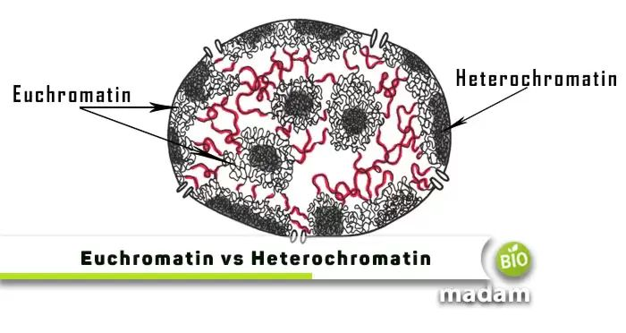

Slide 8


